Slide 1
The 16th IACHEC Parador de La Granja, Spain
The 100m X-ray Test Facility in IHEP and Calibration Plans for the eXTP
Yusa Wang, wangyusa@ihep.ac.cn
On behalf of 100XF team and eXTP-SFA team
May 15 2024

Slide 2
Outline
1
Introduction to IHEP 100XF
2
The completed calibrations in it
3
Calibration Plans for eXTP-SFA

Slide 3
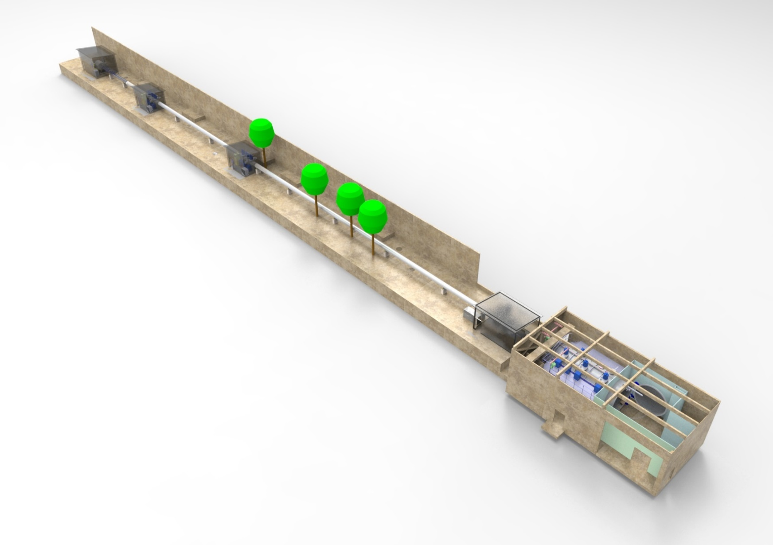
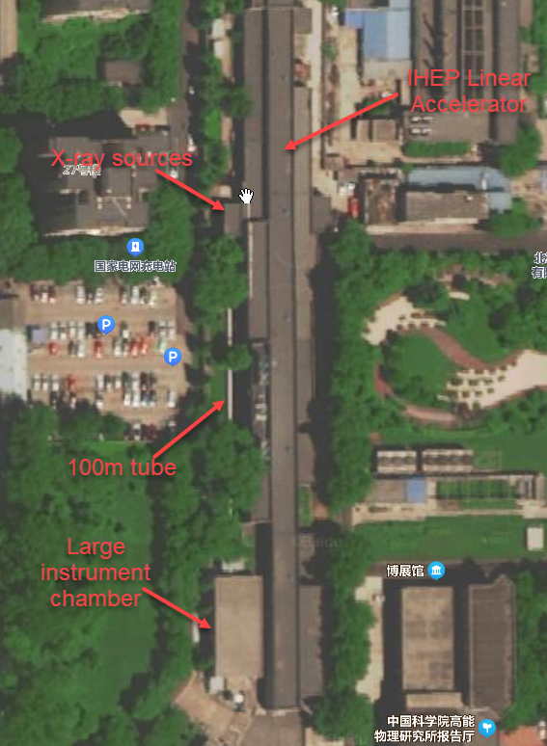
1. Introduction to IHEP 100XF
The biggest X-ray test facility in China
Calibrated the EP FXT and WXT well
X-ray
sources
Pump stations
Big Chamber
Long tube：φ0.6×100m
Big Chamber：φ3.4×8m
Pressure：5×10⁻⁵Pa
Parallelism ＜12′
Movable devices：3″，3μm
Multi-target X-ray source, CCM, Modulated X-ray source, Polarized X-ray source

Slide 4
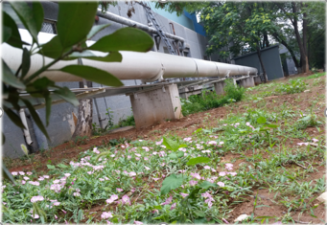
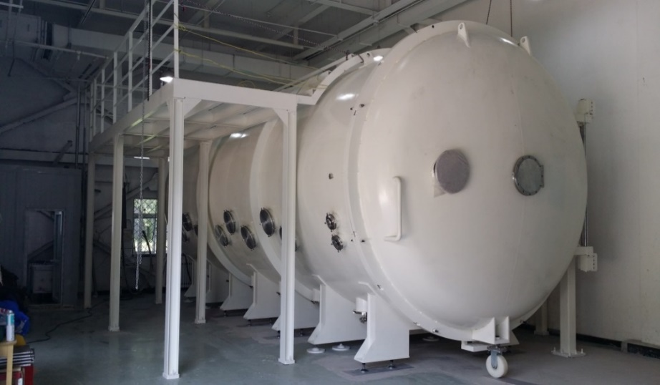
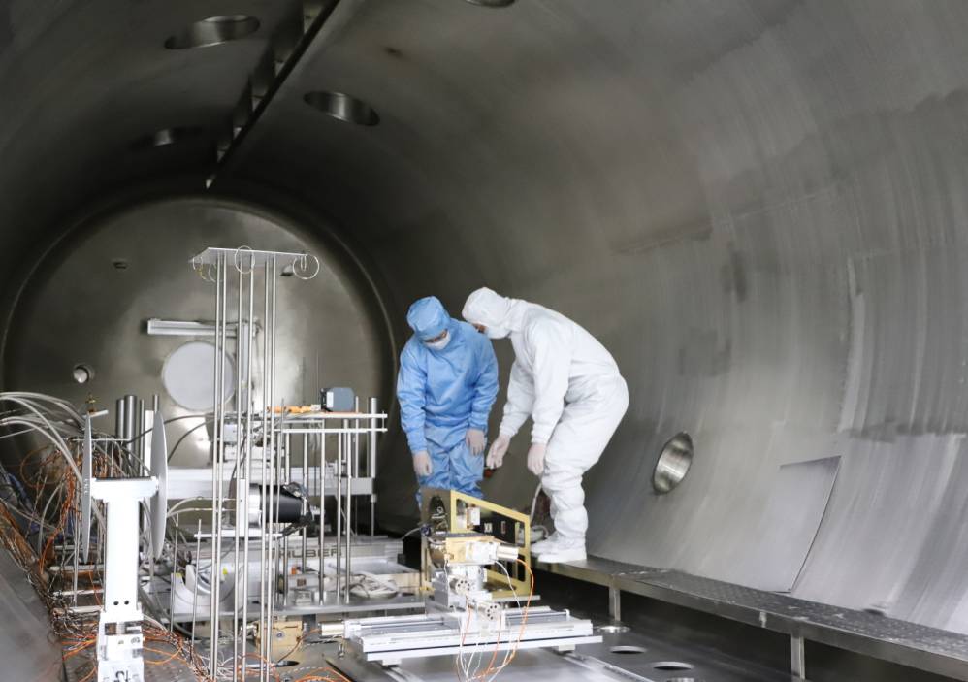
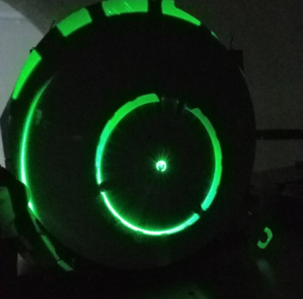
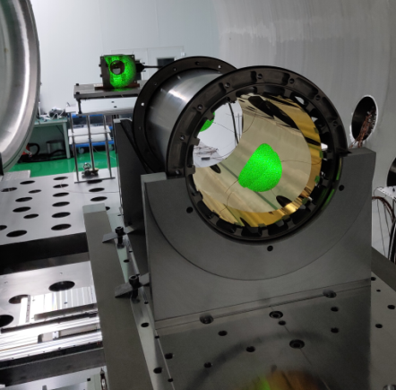
1. Introduction to IHEP 100XF
A whole long tube without joint
With vibration insulator
Contamination control
Laser Alignment
The100m vacuum tube
The big vacuum chamber
Inside the big vacuum chamber
Alignment

Slide 5
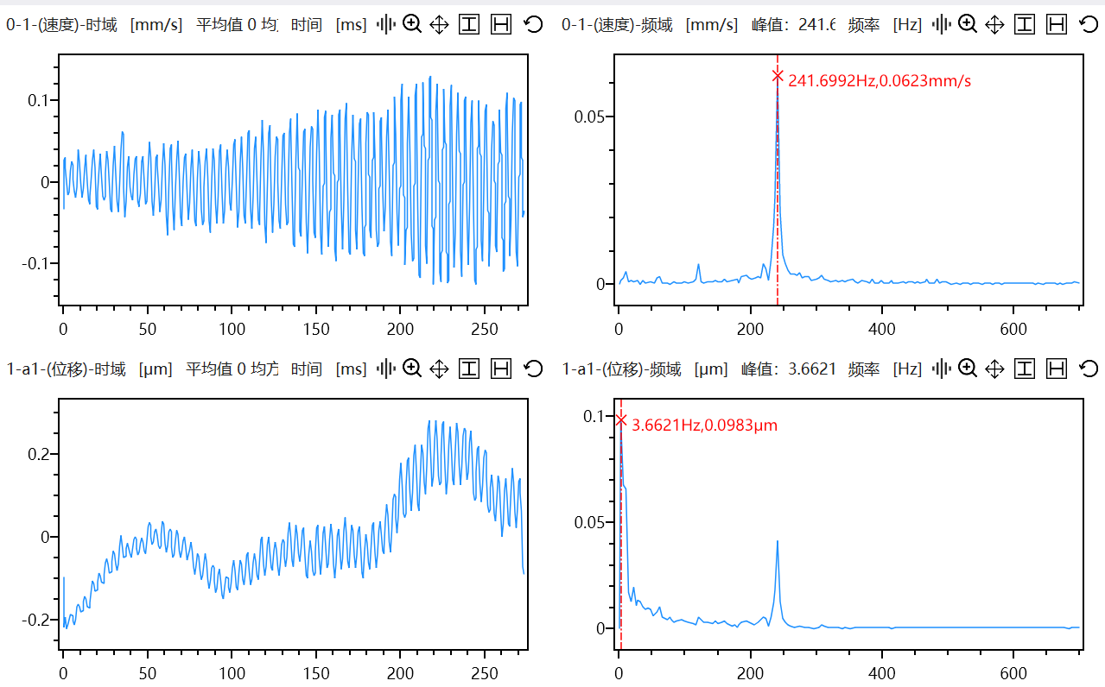
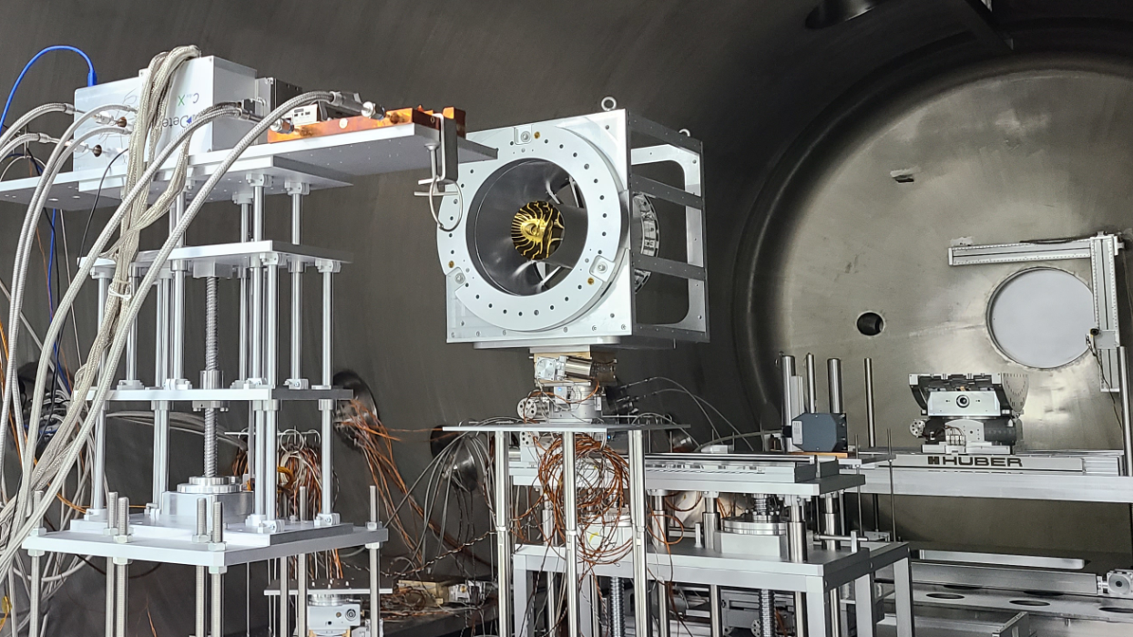
1. Introduction to IHEP 100XF
The vibration was measured, the designed should consider it. The several stages can meet the requirement of different focal length X-ray optics, from 0.1-5.25m.
The primary contribution of vibration is from the low frequency, like human body
3 3-D stages for precise control

Slide 6
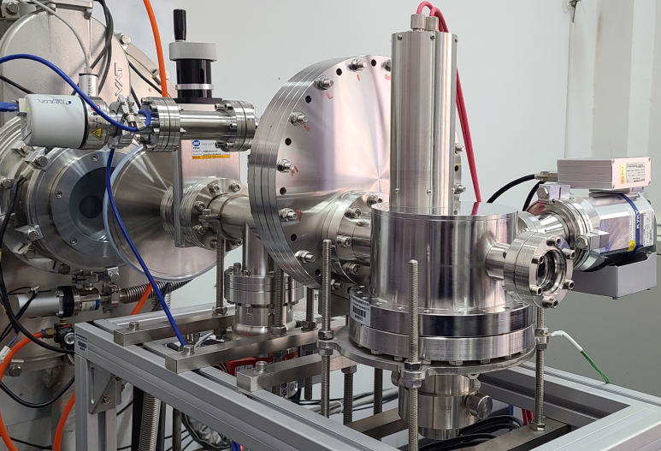
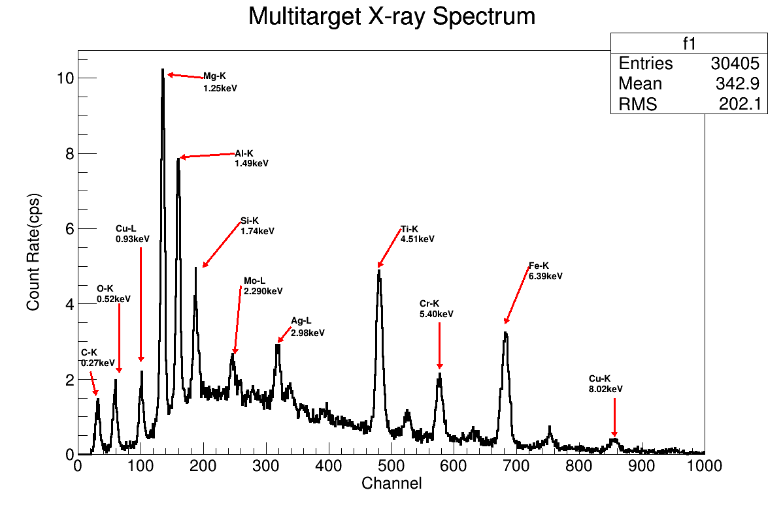
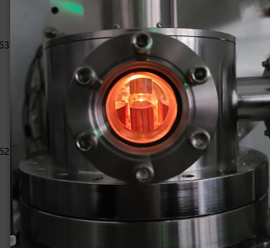
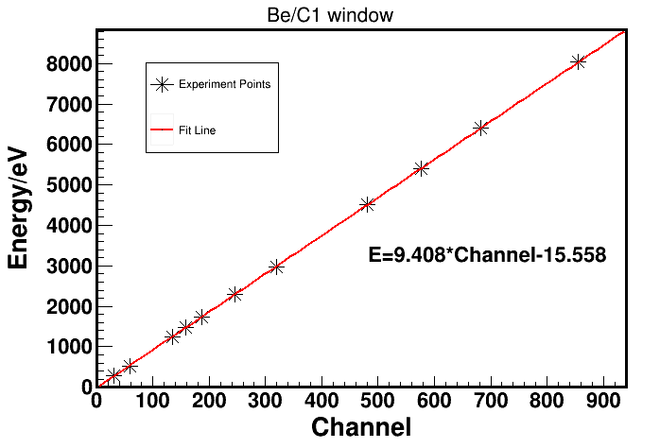
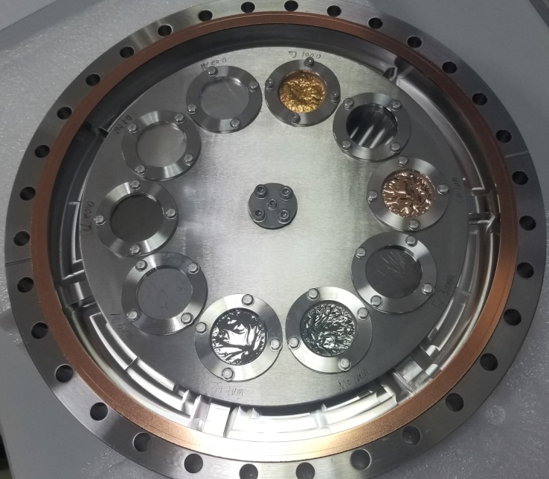
1. Introduction to IHEP 100XF
Beam size: φ600mm
Parallelism ＜12′
Uniformity ＜3%，1%
Stability ＜1%/h，0.5%
Energy range: 0.3-22 keV
Low energy: C-K（277eV）
Ag,Mo,Cu,Fe,Cr,Ti,Al,Mg,C,SiO₂
Multi-target x-ray source

Slide 7
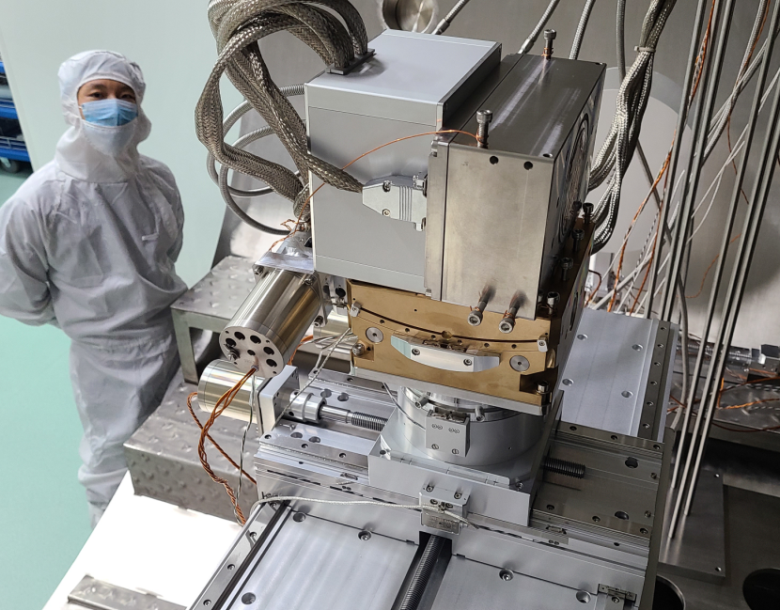
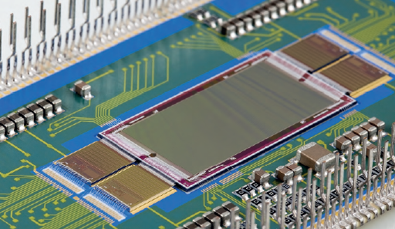
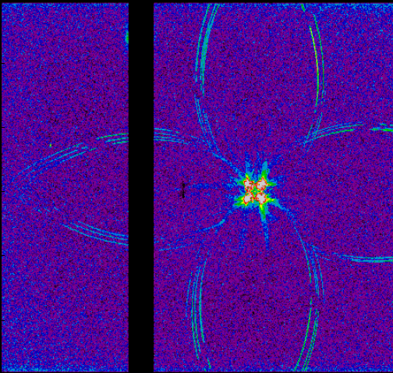
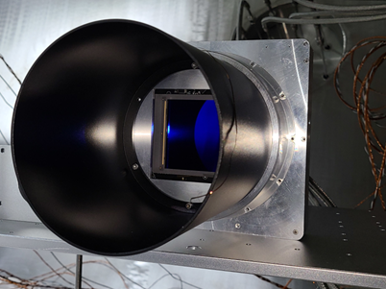
1. Introduction to IHEP 100XF
The CXC is powerful for X-ray optics test
Item | CCD | CXC
Depleted Depth | 5-50μm | 450μm | full
Readout speed | 0.5-50fps | 100-1kfps | Very high
Noise | ＞5e⁻ | 1e⁻@100Hz | Ultra low
FWHM | 180eV | 140eV | Same to SDD
Energy range | 0.5-1keV | 180eV | Very low
Non-linearity | ~1% | ＜0.06% | Perfect
Item | Other CMOS | 6060BSI
Size | 40×40mm | 61×61mm | Ultra large
Resolution | 4k×4k | 6k×6k | well
Pixel Size | 10×10μm | 10×10μm
Single reflection | Out of detection area | detected
Energy range | 0.5-1keV | 0.5-1keV
Non-linearity | ~1% | ＜0.35% | Perfect

Slide 8
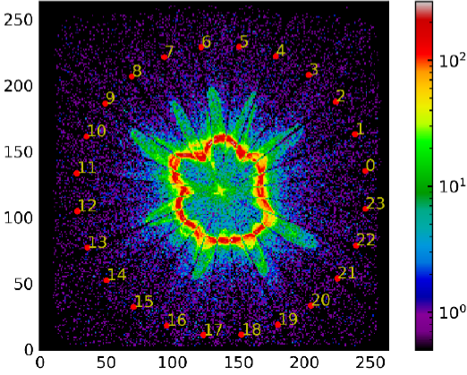
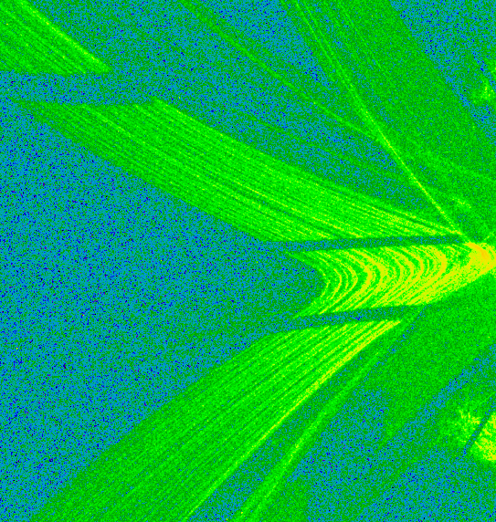
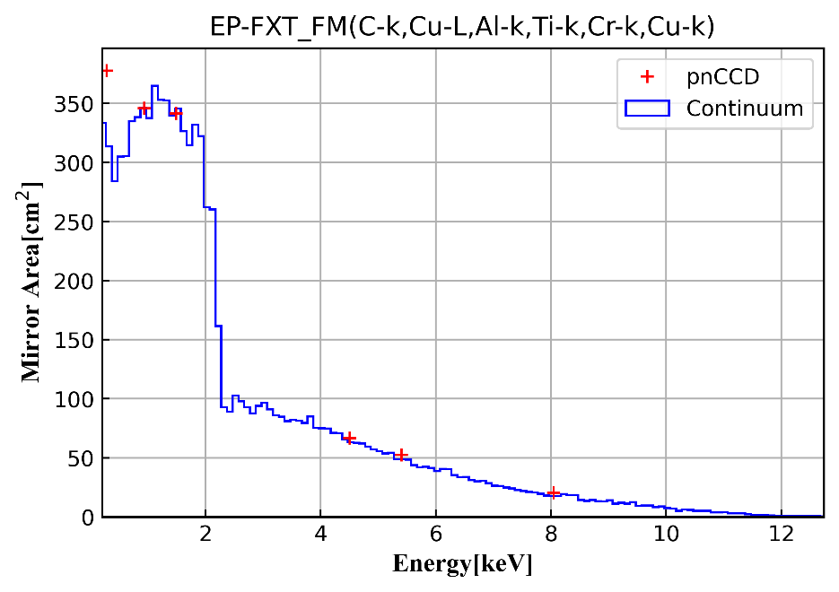
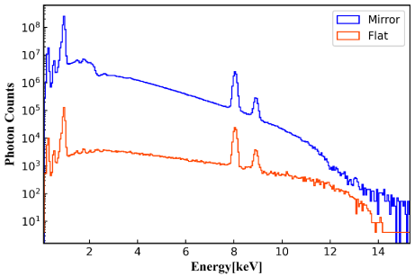
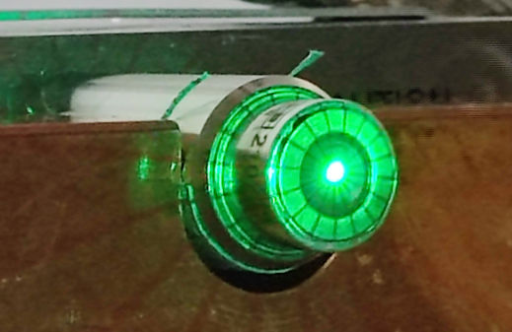
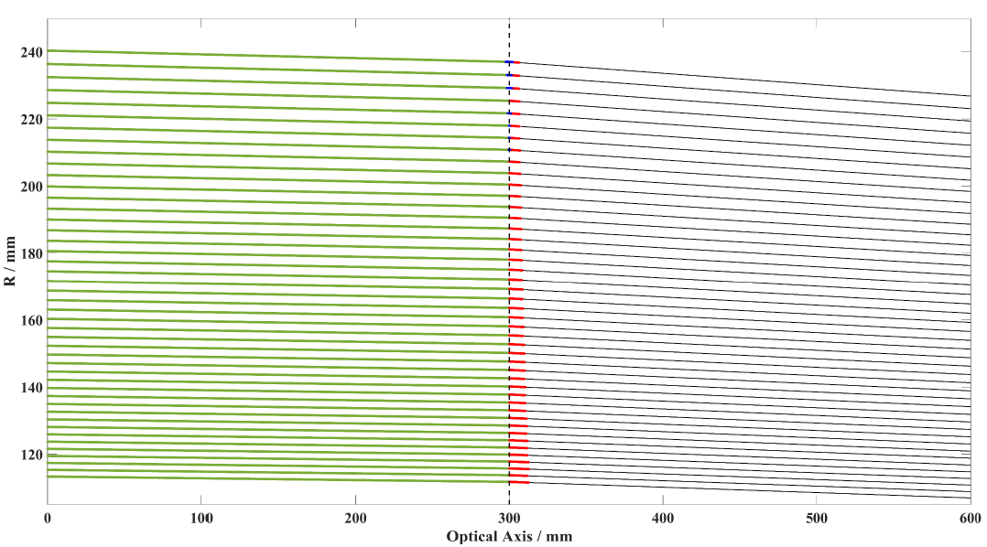
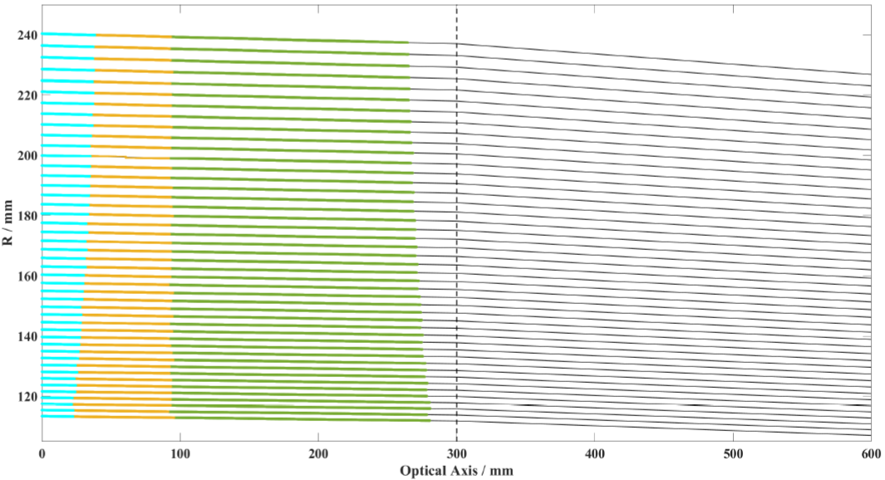
1. Introduction to IHEP 100XF
PTB Calibrated 5%
New method for evaluating performance of mirror in sub-area
Test the profile of mirror through visible ripple
Make fast calibration of effective area in wide energy range through SDD and big format SDD
Parallel X-ray
Quasi-parallel
Confirm some correction methods according to quasi-parallel beam

Slide 9
Outline
1
Introduction to IHEP 100XF
2
The completed calibrations in it
3
Calibration Plans for eXTP-SFA

Slide 10
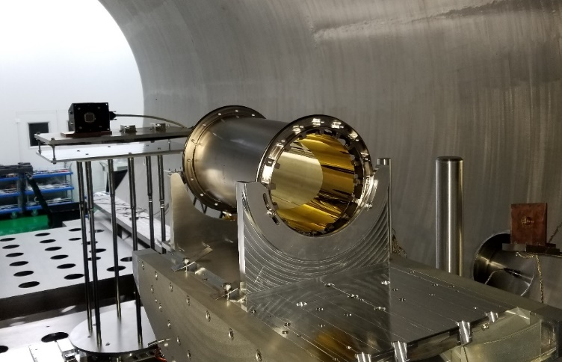
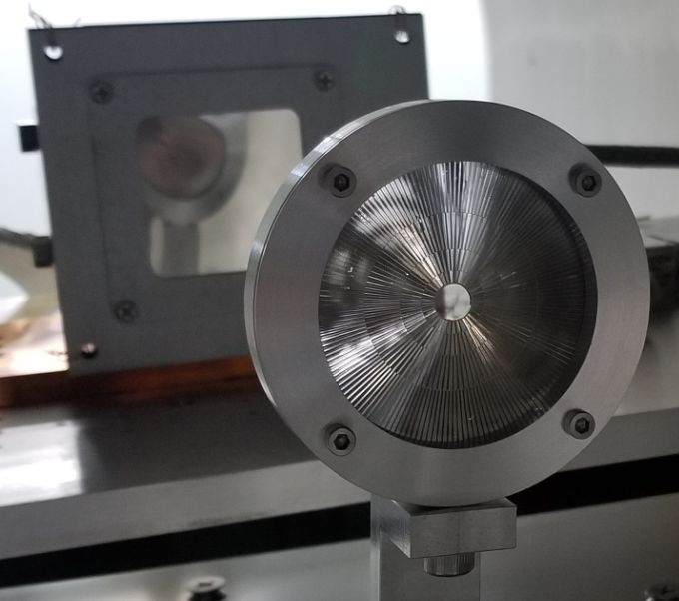
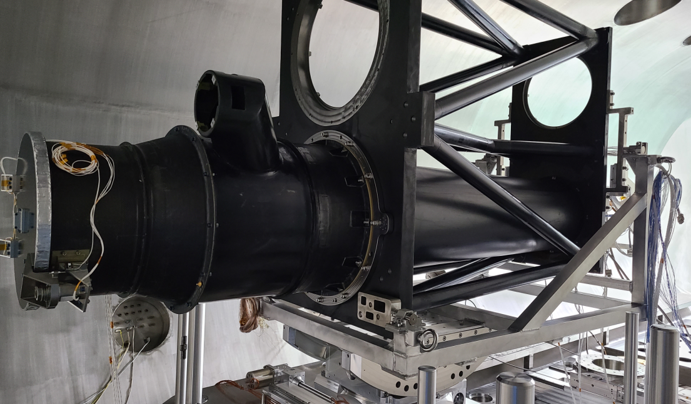
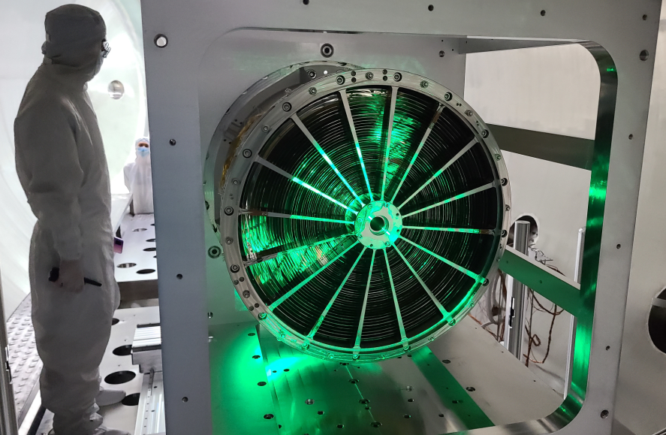
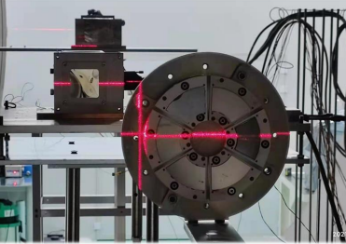
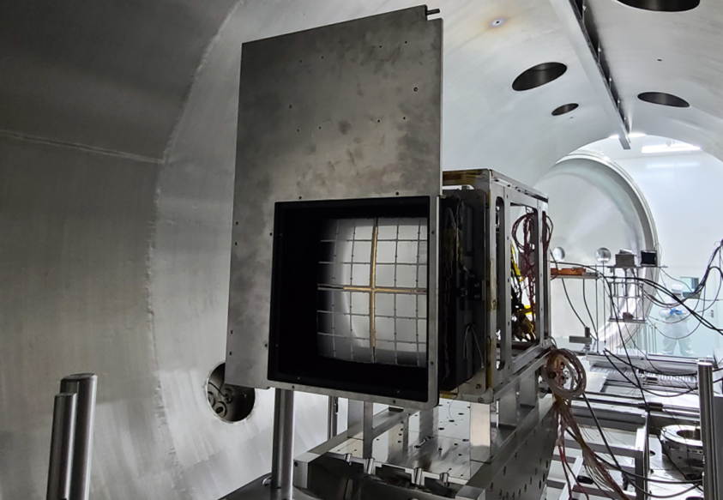
2. The completed calibrations in it
Single shell→Mirror assembly→ Telescope→Other X-ray mirror
Single Wolter I mirror shell
Wolter I telescope
Micro slit optics
Wolter I mirror assembly
Focused MPOS
MPO telescope

Slide 11
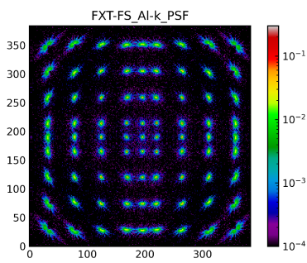
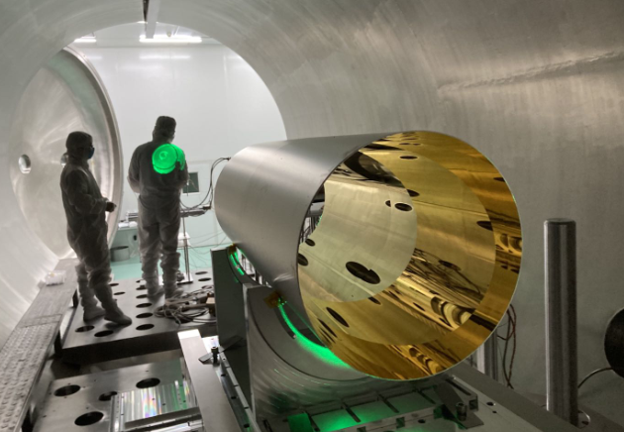
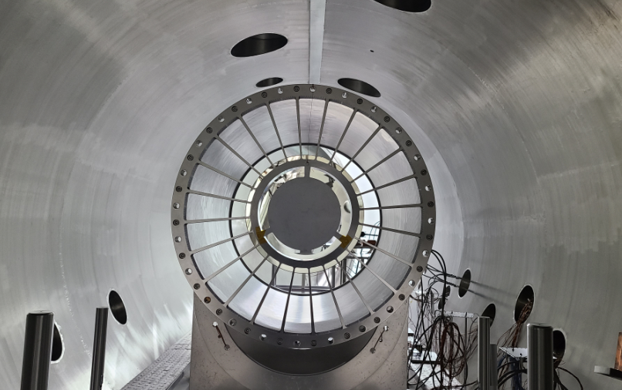
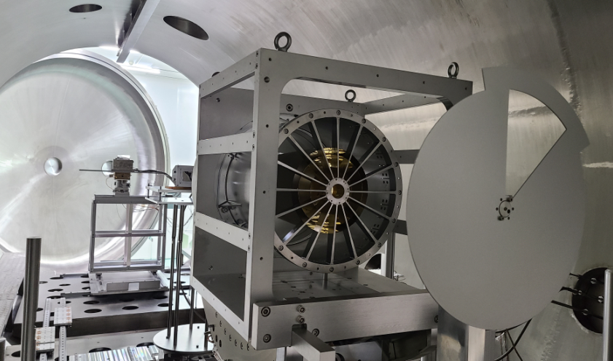
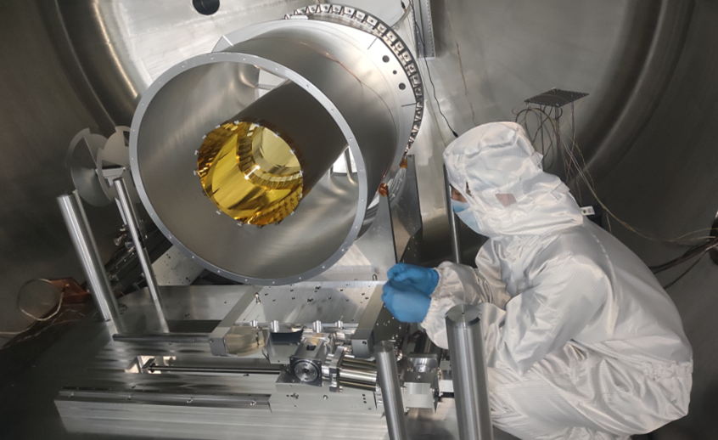
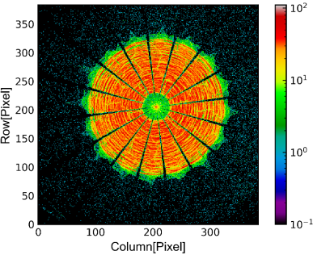
2. The completed calibrations in it
eXTP Single shell
eXTP 45# 1mm
HEW 30″ Al-k
18# 39# 24#
eXTP 45#
HEW 20″ Al-k

Slide 12
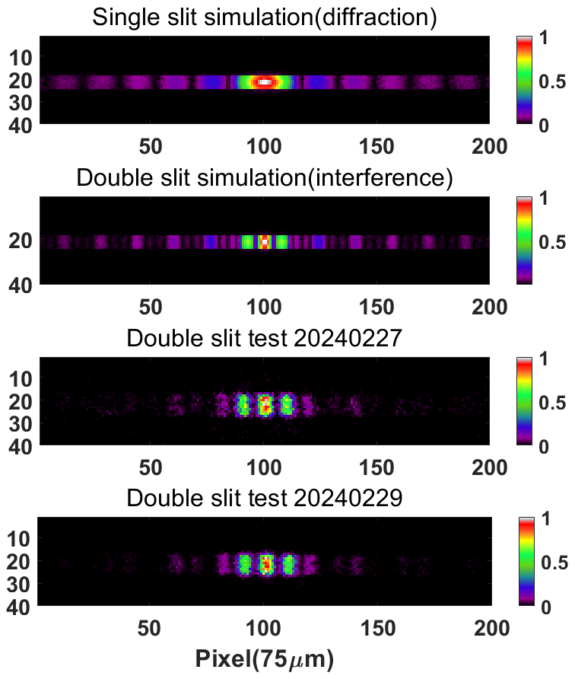
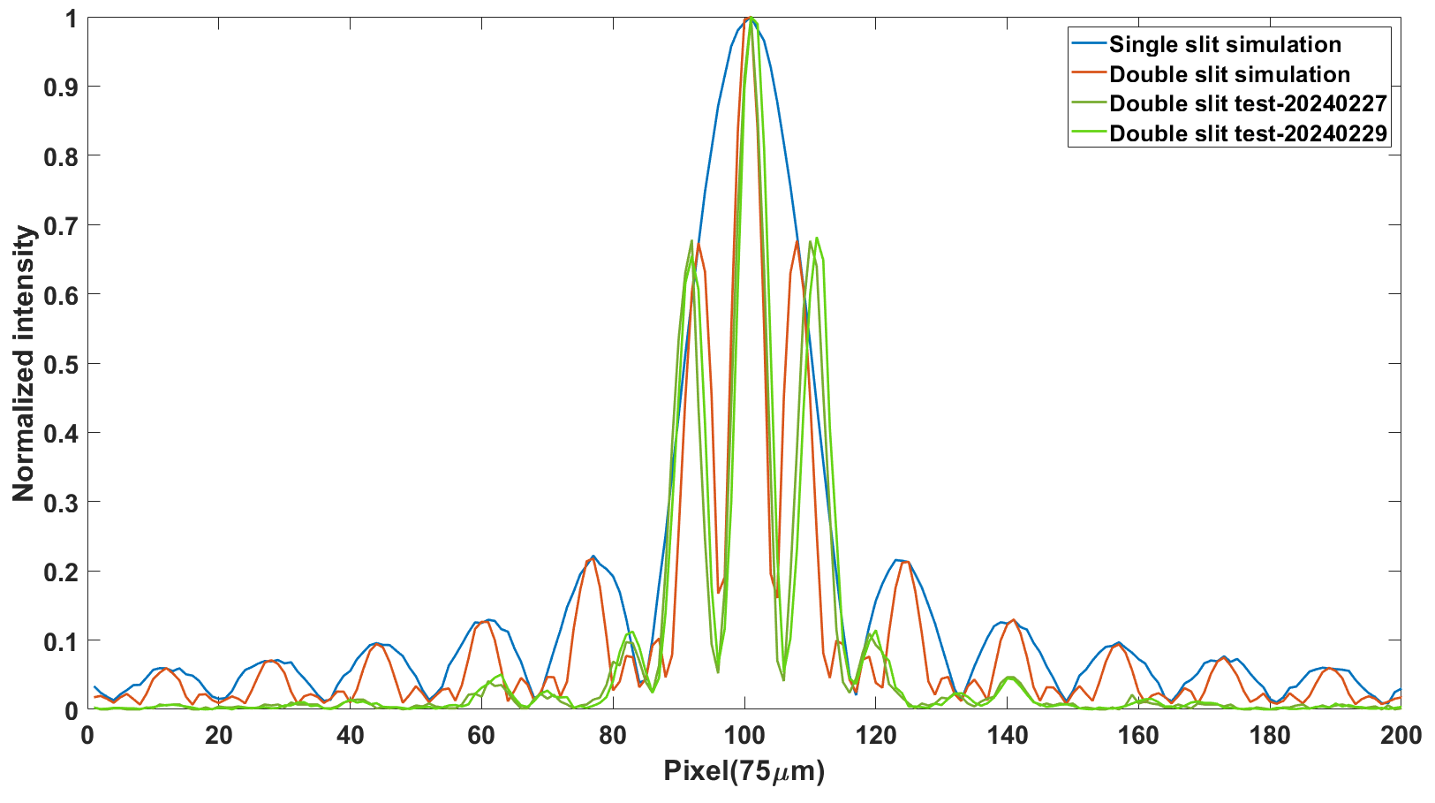
2. The completed calibrations in it
The interference fringes from double slits were detected, the possible X-ray interferometry is trying.

Slide 13
Outline
1
Introduction to IHEP 100XF
2
The completed calibrations in it
3
Calibration Plans for eXTP-SFA

Slide 14
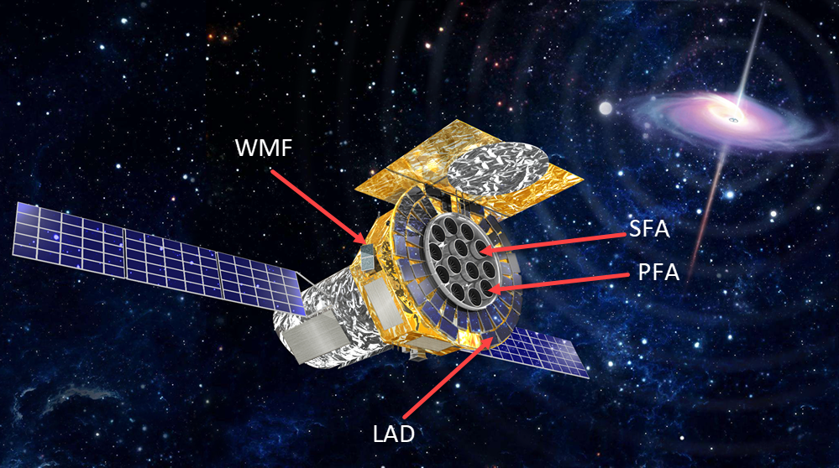
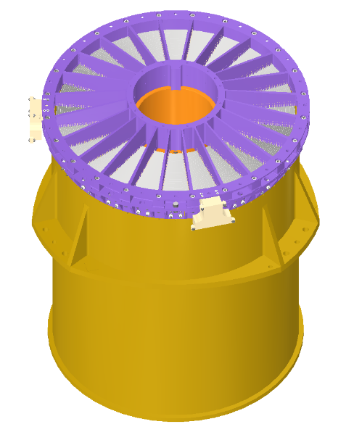
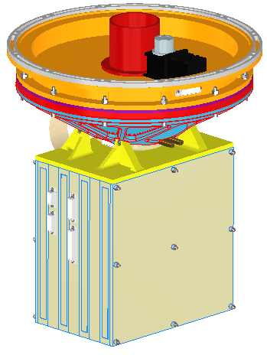
3. Calibration plans for eXTP-SFA
eXTP: enhanced X-ray Timing and Polarimetry Mission
Scientific goal: eXTP is a science mission designed to study the state of matter under extreme conditions of density, gravity and magnetism.
Operation：Pointing observation with high accuracy and stability.
Payload | Configuration | Optics | Detector | Eff. area (m²)
Spectroscopic Focusing Array (SFA) | 9 or 6 telescopes | Wolter-I, nickel | SDD, 0.5-10 keV 180 eV @ 6 keV | 0.6 m²(1-2 keV)
Large Area Detector (LAD) | 40 modules | MCP | SDD, 2-30 keV | 3.1 m² (2-10 keV)
Polarimetry Focusing Array (PFA) | 4 or 3 telescopes | Wolter-I, nickel | GPD, 2-8 keV 1.8 keV @ 6 keV | 380 cm² @ 3 keV
Wide Field Monitor (WFM) | 6 cameras | Coded mask | SDD, 2-50 keV 500 eV @ 6 keV | 3 Sr (FOV)
SFA

Slide 15
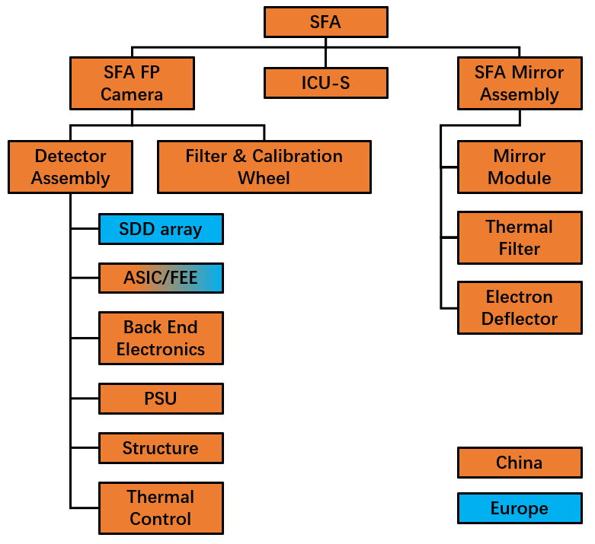
3. Calibration plans for eXTP-SFA
Performance | Value
Number of mirror modules | 9 or 6
Focal length | 5.25m
Envelope | ≤600mm (diameter)
Effective on axis | ≥820cm²@2keV ≥550cm²@6keV
Energy range | 0.5-10keV
Field of view | ≥12′
Angular resolution (HPD) | ＜30″（15″）
Mass budget | ≤130kg
Operation temperature | 20±1℃

Slide 16
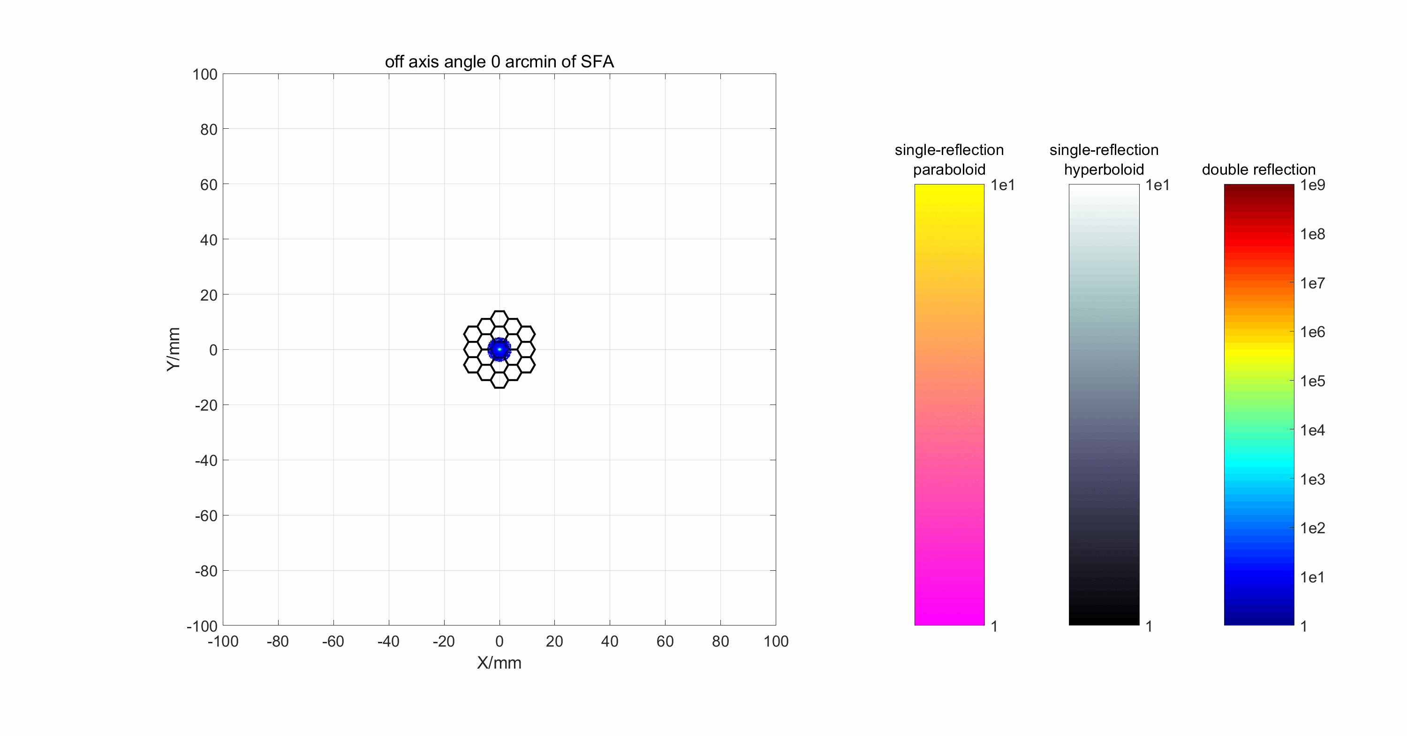
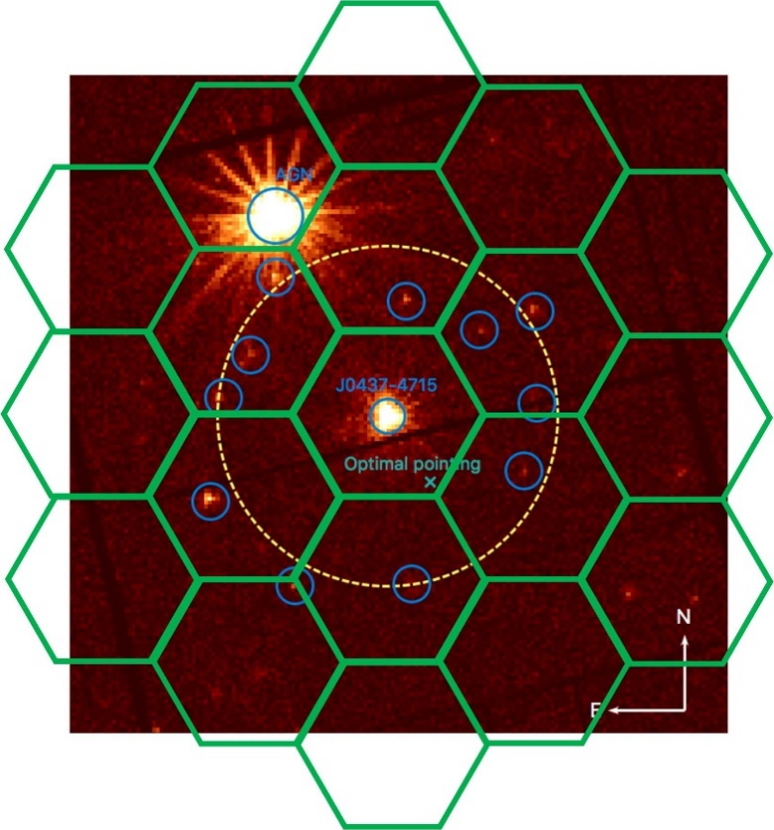
3. Calibration plans for eXTP-SFA

Slide 17
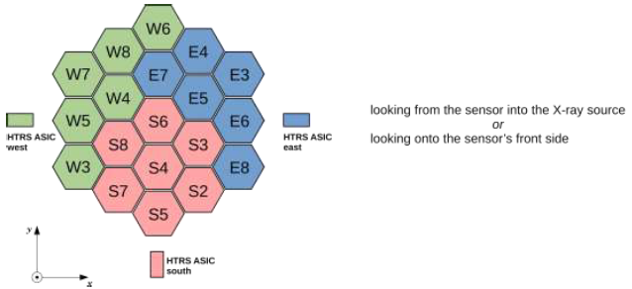
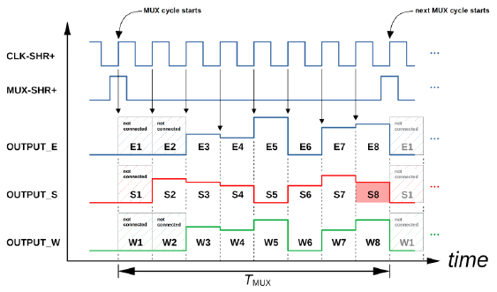
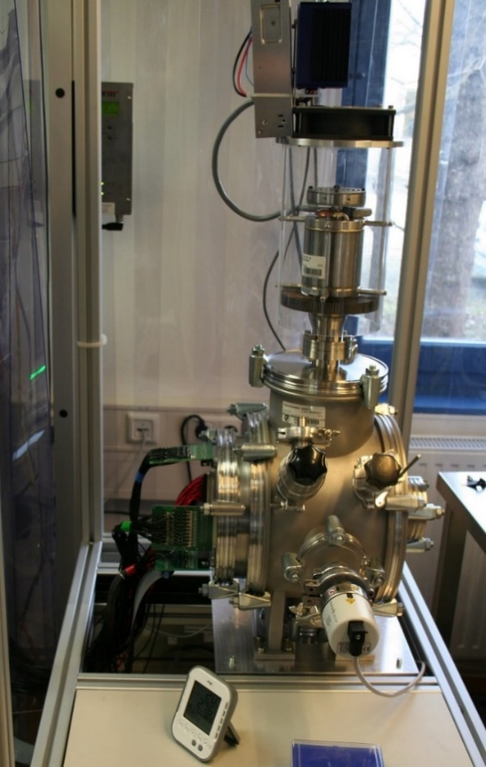
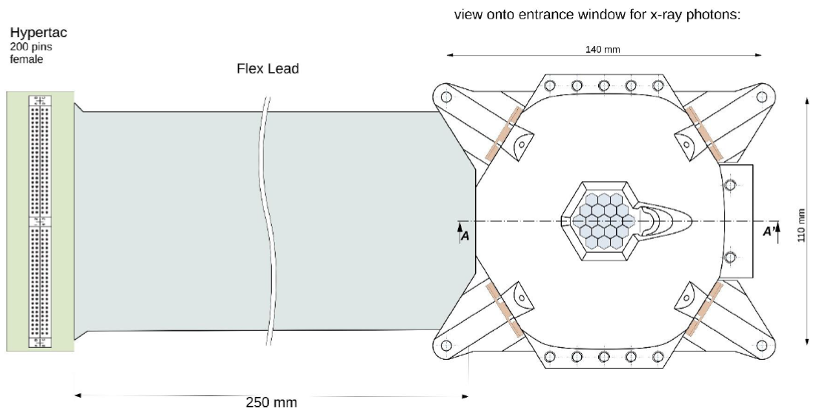
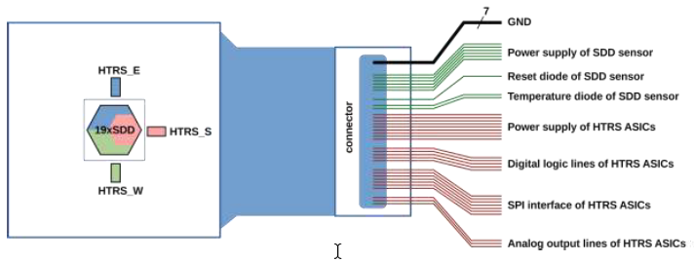
3. Calibration plans for eXTP-SFA
The multi-cell SDD is from MPE, the performance met the requirement of PhaseA & B.

Slide 18
3. Calibration plans for eXTP-SFA
The simple joint multi-cell SDDs were developed and checked, the performance was also good.
Detector shielding box
Energy resolution
@T= −20°C@Count rate≈0.13 kcps
Central channel 153eV@5.9 keV
Maximum source flux ＞40Crab

Slide 19
3. Calibration plans for eXTP-SFA
The whole test of SFA prototype was completed in the 100XF, the sensitive timing is excellent.

Slide 20
3. Calibration plans for eXTP-SFA
A special modulated X-ray source was developed to check the timing performance, the typical Crab and PSR B 1821-24 were simulated and detected well.
13kV, 44uA
Crab profile
13kV, 44uA
PSR B1821–24 profile
13kV, 100uA
Gate: 400ns
Period: 10us
20

Slide 21
3. Calibration plans for eXTP-SFA
The fastest period is 62.5ms without distortion, 31.25us with obvious distortion of light curve.
Expecting a very sensitive X-rat timing instrument in the next 5 years.
21

Slide 22
3. Calibration plans for eXTP-SFA
Calibration requirement for SFA
Device | Process | Content | Description
telescope | reflection | effective area (E,φ) | collecting area, reflectivity, vignetting function
 |  | point spread function (E,φ) | mirror quality
 |  | field of view | focal length, detector geometry
 |  | boresight | alignment
filter | absorption | transmission | filter thickness, pinhole
SDD | charge release | edge effect | the lost of the part of one event
 |  | low energy threshold
 |  | quantum efficiency
 |  | energy resolution
 | charge drifting | Timing | drift time
 |  |  | time resolution
 |  |  | time stability
 | charge readout | readout noise/amplitude | nonlinearity
firmware | Control and signal processing | mode exchange | depending different x-ray sources
 |  | background evaluation

Slide 23
3. Calibration plans for eXTP-SFA
Content | Detailed Content | Device and Facility | Calibration item | Error and difference
EA | EA vs off-axis angle EA vs Energy | Multi-target X-ray source, The 100XF, Standard SDD detector, CXC, Monochromator, Whole support structure, Double wheel | Scanning ±7′ with step 1′，forming 15×15array； With the following energy： C-K（0.28keV）, Cu-L（0.93keV）, Mg-K（1.25keV）, Al-K（1.49keV）, Mo-L（2.29keV）；Ag-L（2.98keV）, Ti-K（4.51keV）, Cr-K（5.45keV）, Fe-K（6.4keV）, Cu-K（8.04keV）, Ge-Kα（9.89keV）, 11keV（Ge-Kβ） | On-axis is 10%，goal is 5%。 Off-axis is 15%，goal is 10%
PSF | PSF vs off-axis angle PSF vs Energy HPD, W90 | Multi-target X-ray source, The 100XF, CXC, Monochromator, Whole support structure | Scanning ±7′ with step 1′，forming 15×15array； With the following energy： C-K（0.28keV）, Cu-L（0.93keV）, Mg-K（1.25keV）, Al-K（1.49keV）, Mo-L（2.29keV）；Ag-L（2.98keV）, Ti-K（4.51keV）, Cr-K（5.45keV）, Fe-K（6.4keV）, Cu-K（8.04keV）, Ge-Kα（9.89keV）, 11keV（Ge-Kβ） | Low flux is needed, without pile-up
FOV | The mirror shells The deformation The Electron Divertor | Multi-target X-ray source, The 100XF, CXC, Whole support structure | Confirm the FOV through the 50% photons | Among the calibration of PSF, the FOV can be obtained
Axis | The angle between the Axis of MM and mounting surface | Cubic mirror, focometer, Monochromator, Whole support structure. | With Al-K and Cu-K, the Axis can be measured | The Axis difference is less than1′，the accuracy of calibration is better than 6″
Focal length | Focal length | focometer, Multi-target X-ray source, CXC, 100XF | With Al-K and Cu-K, the focal length should be measured | Less than 1mm，the accuracy of calibration is 0.1mm

Slide 24
3. Calibration plans for eXTP-SFA
Content | Detailed Content | Device and Facility | Calibration item | Error and difference
QE | QE vs Energy Filters | Multi-target X-ray source, The 100XF, Standard SDD detector, CXC, Monochromator, Whole support structure, Double wheel | The energies are： C-K（0.28keV）, Cu-L（0.93keV）, Mg-K（1.25keV）, Al-K（1.49keV）, Ag-L（2.98keV）, Ti-K（4.51keV）, Cr-K（5.45keV）, Fe-K（6.4keV）, Cu-K（8.04keV）, Ge-Kα（9.89keV）, 11keV（Ge-Kβ） For absorption edge：N（0.41keV）, O（0.54keV）, Al（1.56keV）, Si（1.84keV） | Required 10%，goal 5%; For one absorption edge, 5 points are needed
FWHM | FWHM vs Energy | Multi-target X-ray source, The 8XF and 100XF, Monochromator | The energies are： C-K（0.28keV）, Cu-L（0.93keV）, Mg-K（1.25keV）, Al-K（1.49keV）, Ag-L（2.98keV）, Ti-K（4.51keV）, Cr-K（5.45keV）, Fe-K（6.4keV）, Cu-K（8.04keV）, Ge-Kα（9.89keV）, 11keV（Ge-Kβ） | Better than Fano limit well
Signal Amplitude | Energy-Channel Temperature dependence at -30℃, -10℃, +10℃ | Multi-target X-ray source, The 8XF and 100XF, Monochromator | The energies are： C-K（0.28keV）, Cu-L（0.93keV）, Mg-K（1.25keV）, Al-K（1.49keV）, Ag-L（2.98keV）, Ti-K（4.51keV）, Cr-K（5.45keV）, Fe-K（6.4keV）, Cu-K（8.04keV）, Ge-Kα（9.89keV）, 11keV（Ge-Kβ） Temperature：-30℃, -10℃, +10℃。 | Better than 1%（TBC）
Readout Noise | Peaking time, readout speed .. | Multi-target X-ray source, The 8XF and 100XF, Monochromator | The energies are： C-K（0.28keV）, Cu-L（0.93keV）, Mg-K（1.25keV）, Al-K（1.49keV）, Ag-L（2.98keV）, Ti-K（4.51keV）, Cr-K（5.45keV）, Fe-K（6.4keV）, Cu-K（8.04keV）, Ge-Kα（9.89keV）, 11keV（Ge-Kβ）
Threshold | The detected limit | Multi-target X-ray source, The 8XF and 100XF, Monochromator | Only with C-K（0.28keV）, checking the every performance
Pipeup | Vs the flux | Multi-target X-ray source, The 8XF | The energies are Al-K（1.49keV）, Cu-K（8.04keV） | TBC

Slide 25
3. Calibration plans for eXTP-SFA
Content | Detailed Content | Device and Facility | Instrument level | Importance
EA | Vignetting function EA vs energy Filter transmission QE of SDDs | Ground：Multi-target source, 100XF, Standard SDD, CXC, Monochromator, Whole structure, Double wheel In-orbit：Pointing observation | MM Detector Telescope In-orbit | Core requirement
PSF | PSF vs off-axis angle PSF vs energy HPD, W90 | Ground：Multi-target source, CXC, 100XF, Whole structure In-orbit：small sky survey | MM Telescope | Core requirement
RMF | FWHM vs Energy | Ground：Multi-target source, Standard SDD, CXC, 8XF, 100XF In-orbit：Pointing observation | Detector Telescope In-orbit | Core requirement
 | Signal Amplitude vs energy |  | Detector Telescope In-orbit | Core requirement
AXIS | The difference between MM AXIS and the mounting surface | Cubic mirror, Focometer, CXC, Multi-target source, 100XF | MM | Important requirement
Focal length | Focal length | Focometer, Multi-target source, CXC, 100XF | MM | Important requirement

Slide 26
Summary
The 100XF in IHEP completed the test and calibration of EP efficiently!
The experience of the past 5 years makes the calibration eXTP-SFA confidently!
Expecting a powerful X-ray timing instrument （SFA） in the next 5 years!
Hoping X-ray ground calibration collaboration in the 100XF.
Yusa Wang, IHEP, CAS
wangyusa@ihep.ac.cn
26

Slide 27
Thank you!

